Slide 1
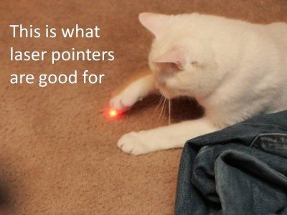
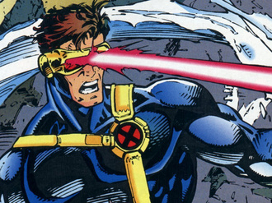
Laser Cat
Presented by:
Almeda Glenn Brandon Tan Troy Toh Lim Wei Heng
Credits are given to the pictures in this presentation

Slide 2
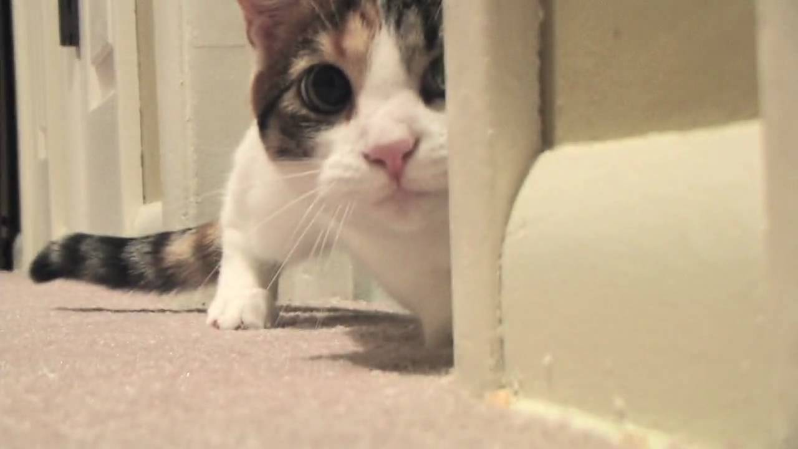
Overview
Gameplay Samples
Screenshots (Before & After)
Reviews(?)
Risks/Concerns
Random Inspirations
Q&A

Slide 3
Gameplay Samples

Slide 4
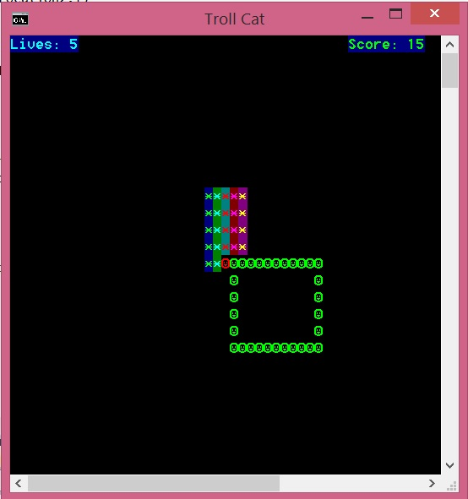
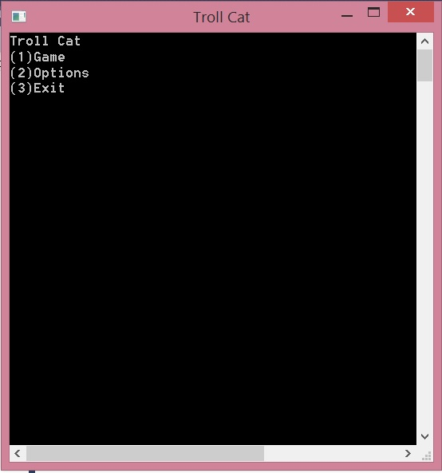
Screenshots (Before)
Initial Menu →
← Initial Gameplay

Slide 5
Screenshots (After)
//final product of the game

Slide 6

Risks/Problems/Concerns
//to brainstorm some potential issues we are aware of….

Slide 7
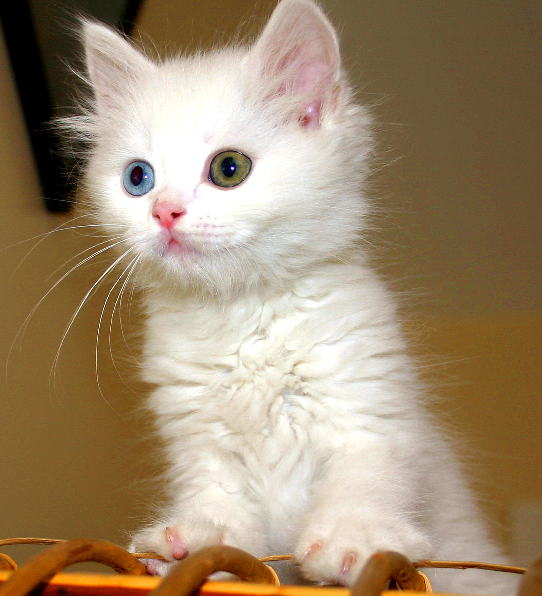
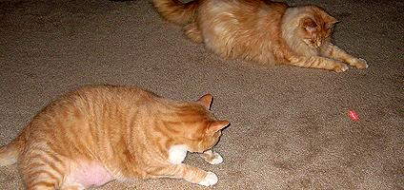
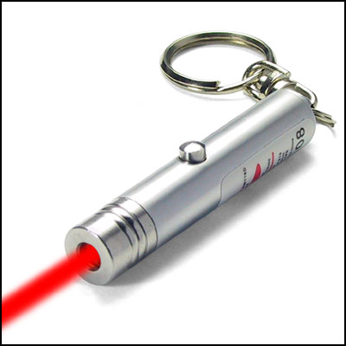
Inspirations

Slide 8
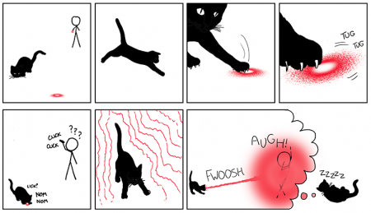
Inspirations

Slide 9
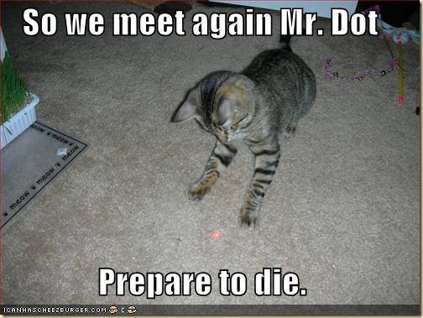
Thank You!!

